Slide 1

ARTIFICIAL INTELLIGENCE AND BUSINESS
THE NEXT 10 YEARS

Slide 2
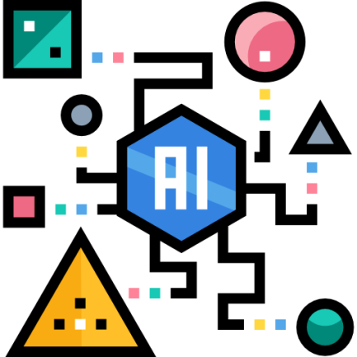


Introduction
Core Driver
Reshape Industry
People and AI work together

Slide 3


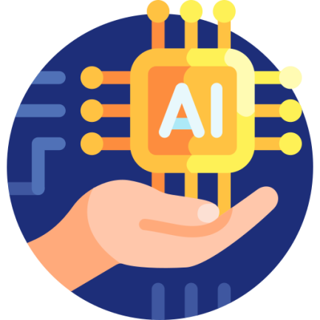
Automation
Perform Repetitive Tasks
Customer Service Chatbots
Shift toward Managing AI Systems

Slide 4


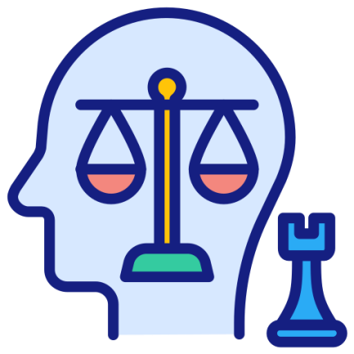
Decision-Making
Analyzes Large Data
Detect Risks
Strategic Decisions

Slide 5



Customer Experience
Highly Personalized Experience
Marketing Strategies
Improve Satisfaction

Slide 6





Industry Impacts
Healthcare
Finance
Retail
Logistics
Education

Slide 7


New Roles
New Careers
Human-AI

Slide 8

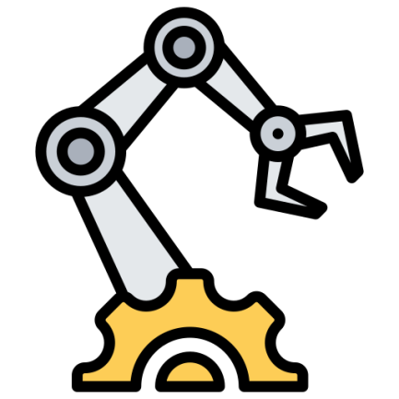

Conclusion
Transform
Automate
Competitive Advantage

